Slide 1










EDA ON AIRBNB LISTINGS
Presentation by
Priti Saha
ID – 231001001060
TEAM 1
Guided by
Himanshu Souda

Slide 2




INTRODUCTION
A Airbnb has become one of the world’s most popular short-term rental platforms.
This project performs Exploratory Data Analysis (EDA) on Airbnb listings to understand:
Pricing patterns
Popular neighbourhoods
Host behaviour
Review trends
Availability patterns

Slide 3




Project Objectives
Understand the distribution of prices
✔ Identify top neighbourhoods with maximum listings
✔ Analyse room type popularity
✔ Study availability trends
✔ Examine review patterns
✔ Provide data-driven insights for hosts & travellers
Organized travel
Stress free trip
Better experience

Slide 4



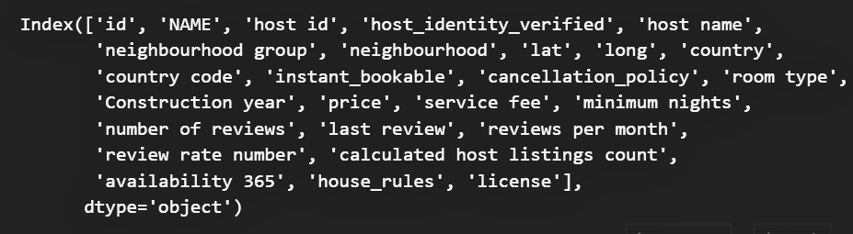

Dataset Overview
Key columns used:
price
room_type
neighbourhood
host_id
number_of_reviews
availability_365
minimum_nights
latitude & longitude

Slide 5
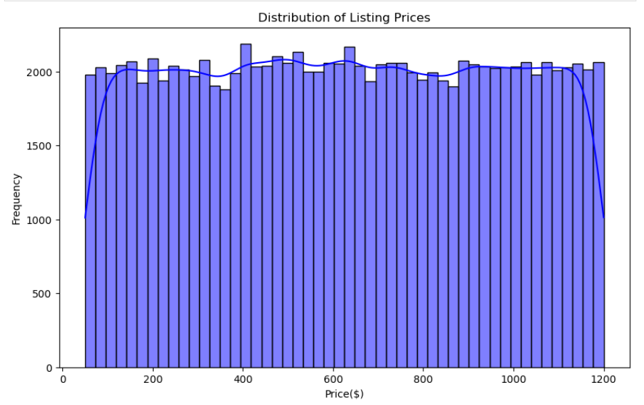



Price Distribution
Prices are highly right-skewed
Majority listings fall under ₹X – ₹Y range
Few luxury listings increase overall mean
Set travel budget
Plan expenses
Emergency funds

Slide 6



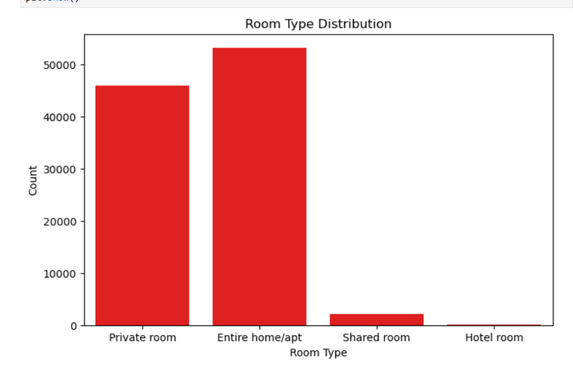
Room Type Analysis
Most common room types:
Entire home/apartment
Private room
Shared room
Hotel room
Insights:
Entire homes are highest in price
Private rooms are most common on the platform

Slide 7
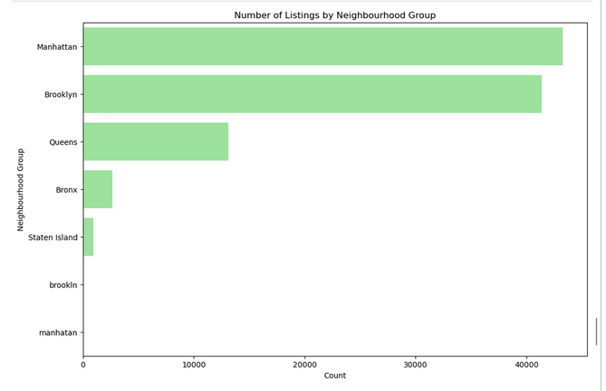
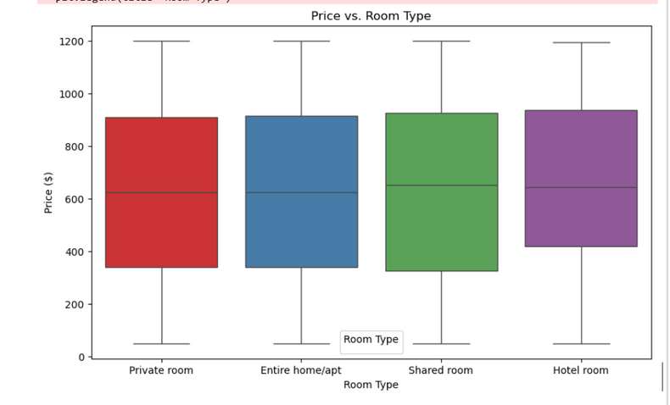





Neighbourhood Analysis
Top neighbourhoods:
Area 1
Area 2
Area 3
Insights:
Central or tourist-heavy areas have higher prices
Some cheaper outskirts areas still have high number of listings
Availability Analysis
Most listings have low availability, indicating high booking demand
Listings available for >300 days might indicate poor host ratings or new hosts
Seasonal trends observed (if applicable)

Slide 8



Tools Used
Numpy
Python
Pandas
Matplotlib
Seaborn
Streamlit

Slide 9


Conclusion
Exploratory Data Analysis reveals:
Strong pricing patterns
Popular areas for rentals
Useful insights for travellers & hosts
Potential improvement areas for host profiles
This analysis can be expanded using:
Machine learning price prediction
Sentiment analysis on reviews
Geospatial heatmaps

Slide 10


Thank you
for reviewing this analysis.
All related files, scripts, and the interactive dashboard can be explored using the links below.
GitHub Repository
https://github.com/pritisaha-5/EDA-on-AirBnb-Listings
Streamlit Dashboard
https://eda-on-airbnb-listings-fcua2sampsigtalnxntk78.streamlit.app/

